Slide 1
Array in c# programing
Bubble Sort, Linear Search, Binary Search Program
By
VARUN SAI KUMAR CHEGONI
Nations Benefits Healthcare and Technology

Slide 2
Content
Bubble Sort using Array in C#,
Example Explanation
Code
Output

Slide 3
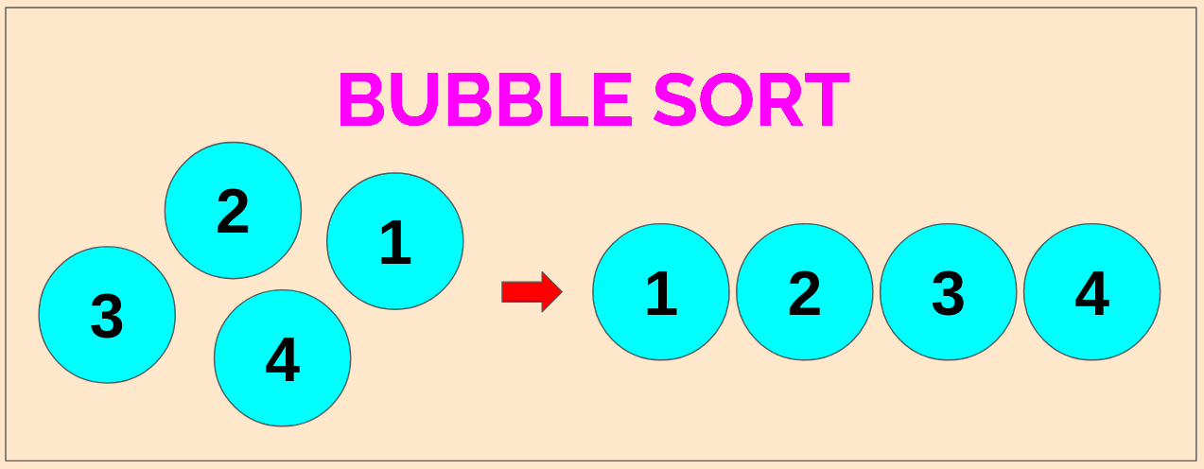
Bubble sort using array in c#
Bubble sort is a simple sorting algorithm. This sorting algorithm is a comparison-based algorithm in which each pair of adjacent elements is compared and the elements are swapped if they are not in order.

Slide 4
Example Explanation:
Let’s Consider int of Arrays has 5 elements − int[] arr = { 78, 55, 45, 98, 13 };
Performing Bubble Sort.
Start with the first two elements 78 and 55. 55 is smaller than 78, so swap both of them. Now the list is −
55, 78,45,98, 13

Slide 5
Now 45 is less than 78, so swap it.
55, 45, 78, 98, 3
Now 98 is greater than 78, so keep as it is.
3 is less than 98, so swap it. Now the list looks like −
55, 45, 78, 3, 98
This was the first iteration. After performing all the iterations, we will get our sorted array using Bubble Sort −
3, 45, 55, 78, 93

Slide 6
Code:
using System;
using System.Collections.Generic;
using System.Linq;
using System.Text;
using System.Threading.Tasks;
namespace BubbleSortusingArray
{
internal class Program
{

Slide 7
static void Main(string[] args)
{
int[] arr = { 78, 55, 45, 98, 13 };
int temp;
for (int j = 0; j <= arr.Length - 2; j++)
{
for (int i = 0; i <= arr.Length - 2; i++)
{
if (arr[i] > arr[i + 1])
{
temp= arr[i + 1];
arr[i + 1] = arr[i];
arr[i] = temp;
}
}

Slide 8
}
Console.WriteLine("Sorted:");
foreach (int p in arr)
Console.Write(p + " ");
Console.Read();
}
}
}

Slide 9
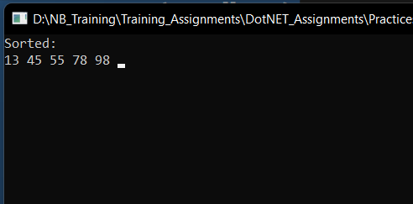
Output:

